Slide 1


Node Exporter: Monitoring Your Linux Servers
Node Exporter is not related to NodeJS. It exposes hardware and OS metrics from Unix-based kernels. Prometheus uses it to gather essential system data.
by Arman Rasouli

Slide 2

Core Metrics Exposed by Node Exporter
CPU Usage
System, user, idle, and I/O wait times tracked
Disk I/O
Monitors reads, writes, and utilization percentages
Memory Utilization
Reports active, inactive, used, and free RAM
Network I/O
Tracks bytes sent/received, errors, and packets

Slide 3
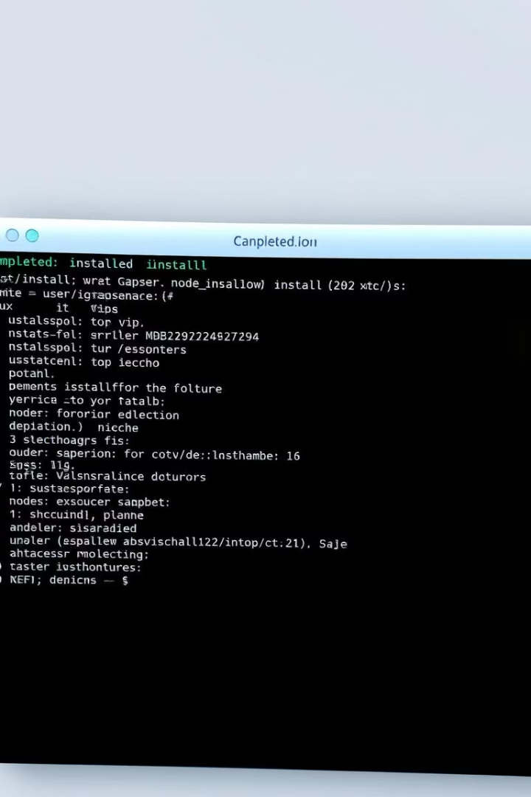
Installing and Configuring Node Exporter
Download Binary
Get from official Prometheus website
Extract Files
Use tar command to unpack the package
Run Exporter
Start node_exporter on default port 9100
Configure Prometheus
Set scrape URL to http://<host>:9100/metrics

Slide 4
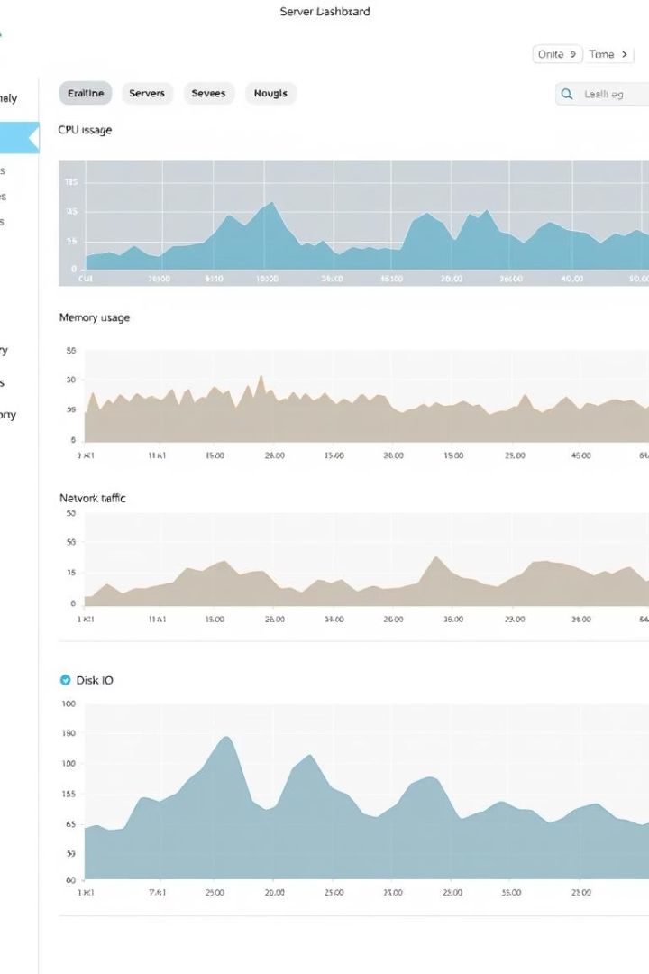




Benefits of Using Node Exporter
Resource Insight
Provides detailed data on server utilization
Performance Detection
Helps identify bottlenecks and anomalies early
Proactive Monitoring
Supports alerting via Prometheus integrations
Health Visualization
Enables clear server status on Grafana dashboards

